Slide 1
Introduction to Three-Tier Architecture
UI, BLL, and DBAL Explained

Slide 2
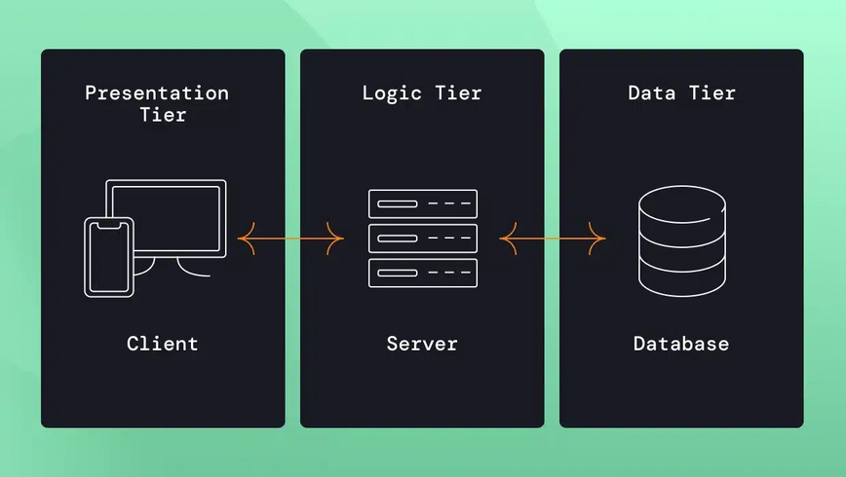
What is 3-Tier Architecture?
A model that separates an application into three distinct parts: UI, BLL, and DBAL.

Slide 3
UI - User Interface / Presentation Layer
Description: The layer users interact with.
Function: Displays information and takes user input.
Technologies: HTML, CSS, JavaScript (React, Angular, etc.)
Example: Websites or mobile app interfaces with buttons, forms, images.
Users can browse products, add to cart, and enter payment details via the UI.

Slide 4
BLL - Business Logic Layer / Application Layer
Description: The brain of the application.
Example: Processes actions like 'Add to Cart,' checks stock, calculates prices.
Function: Executes business rules, performs calculations, interacts with DBAL.
Technologies: Java, Python, Node.js.
The BLL checks stock, updates the cart, and calculates the total prices.

Slide 5
DBAL - Data Access Layer / Database Layer
Description: Manages data storage and retrieval.
Example: Holds product data, user information, past orders.
Function: Communicates with BLL, stores and retrieves data.
Technologies: MySQL, MongoDB, PostgreSQL.
The DBAL stores product info, order history, and retrieves data on request by the BLL.

Slide 6
3-Tier Architecture in Action
Scenario: UI takes user input, BLL processes it, DBAL stores/retrieves necessary data.
Process: UI -> BLL -> DBAL interactions form a seamless application flow.

Slide 7
Why Use 3-Tier Architecture?
Easier Maintenance
Enhanced Security
Separation of Code

Slide 8
Summary of 3-Tier Architecture
Recap: UI, BLL, and DBAL work together to build efficient, scalable applications.

Slide 9
Questions?

